Slide 1

Automated Smart Dustbin
TECHINICAL MODEL DISPLAY
TEAM MEMBERS
KATHAN MASTER
ADITYA SINGH

Slide 2
OBJECTIVE
INTRODUCTION
OUR SOLUTION
OUR TOPIC
CONCLUSION

Slide 3
OUR TOPIC
In our India, we had seen land pollution in our area like on roads, collage campus , railway station our society and apartments. Even we had Dustin people are throwing their waste anywhere.
OUR WAY TO SOLVE
To overcome we had made a prototype model in which we are going to collected waste from roadside, railway station, society's and apartment's and collage campus. So there will be clean city and free from land pollution.

Slide 4
OUR SOLUTION
We are developing mechanical and Electronic system. Which can automatically collect the waste from open area & dump it into its dustbin and also it can inform user when dustbin is full.

Slide 5
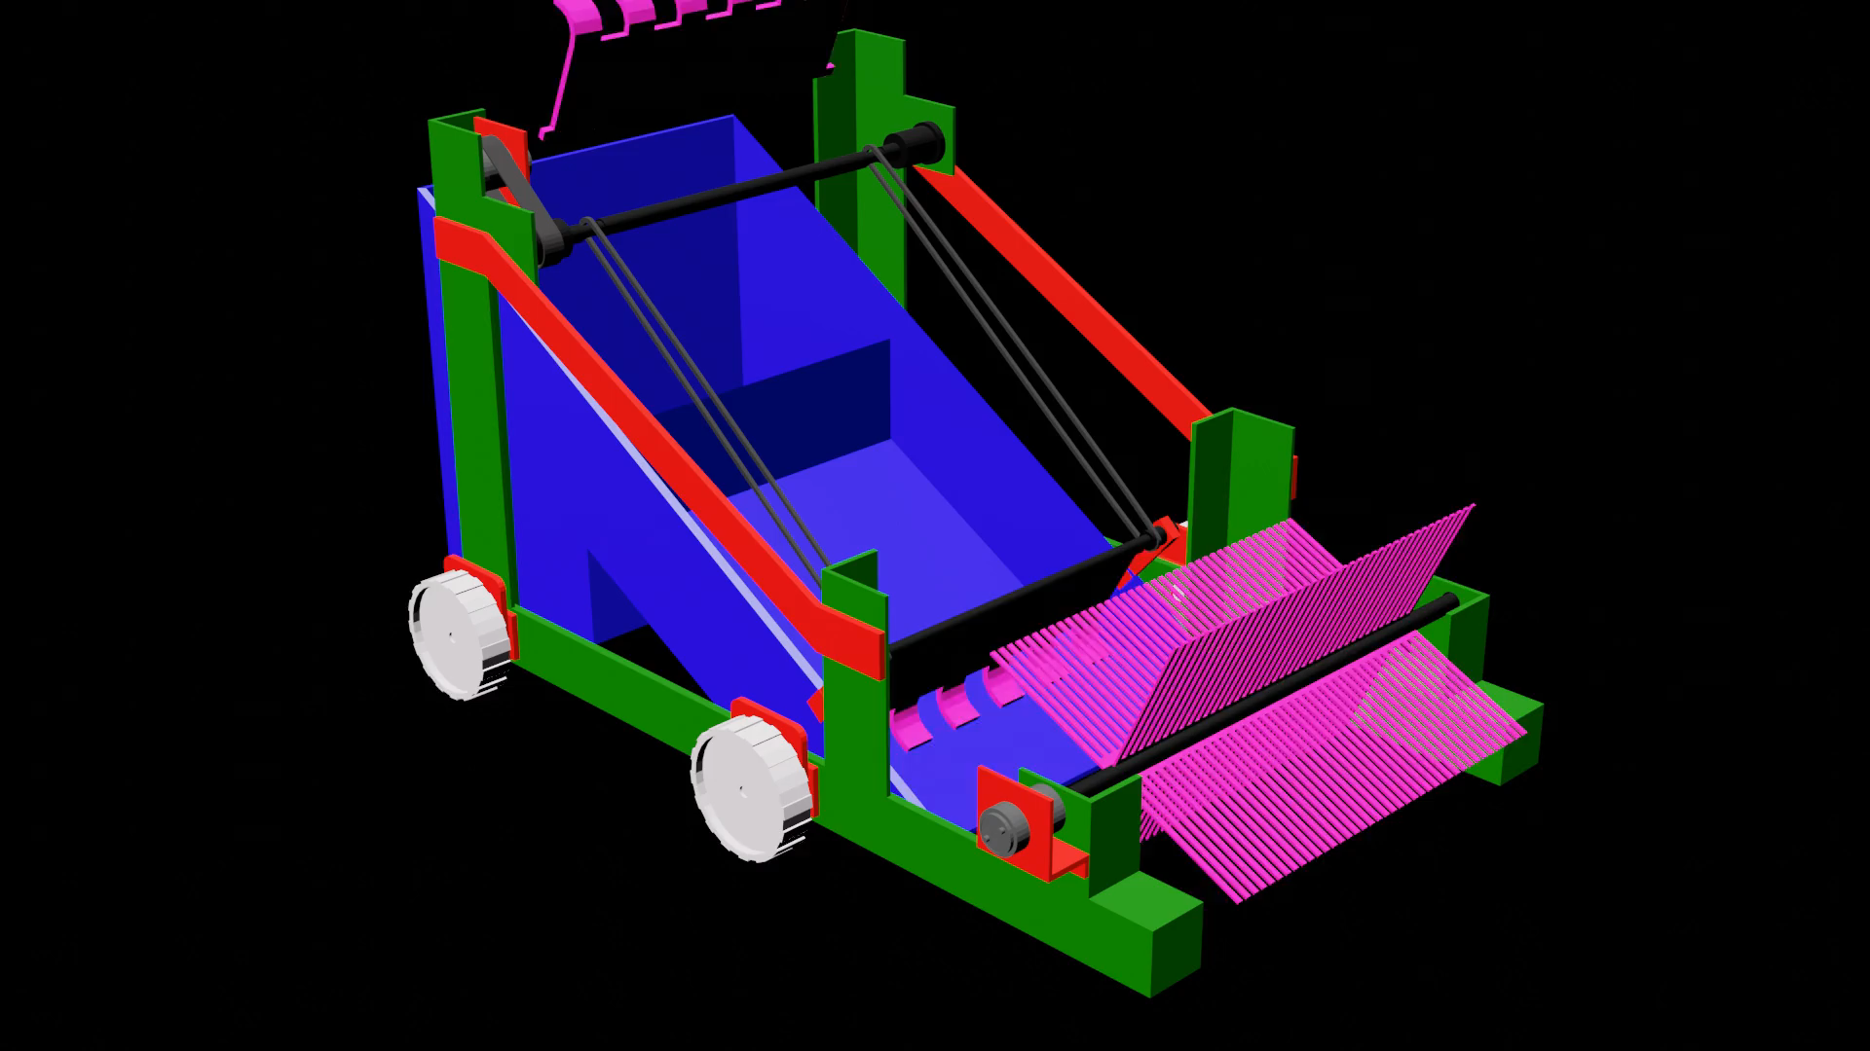
CAD MODEL

Slide 6
DIMENSION
FRONT VIEW
SIDE VIEW
25 CM
20 CM
90 CM
65 CM
6 CM
30 CM
60 CM
30 CM

Slide 7
FLOW CHART
CHAIN WILL LIFT UP THE WASTE MATERIAL THROUGH RAKE
COLLECT THE WASTE MATERIAL FROM COLLECTED DUMP INTO IT’S DUSTBIN.
DC MOTOR 1 CONNECTED TO AXLE AND CHAIN.
ELECTRICAL SUPPLY
GIVEN TO DC MOTOR
DC MOTOR 2 CONNECTED TO AXLE WITH GROOM WHICH WILL COLLECT WASTE FROM OPEN AREA AND .
MOVE WASTE TOWARDS RAKE
AS DUSTBIN WILL FULL WITH WASTE MATERIAL THEN SYSTEM WILL AUTOMATICALLY STOP.

Slide 8
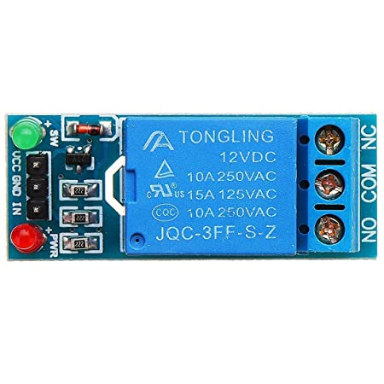
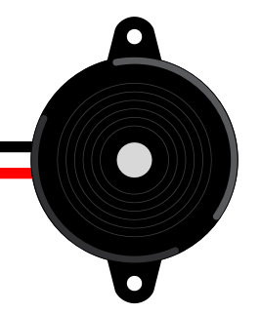
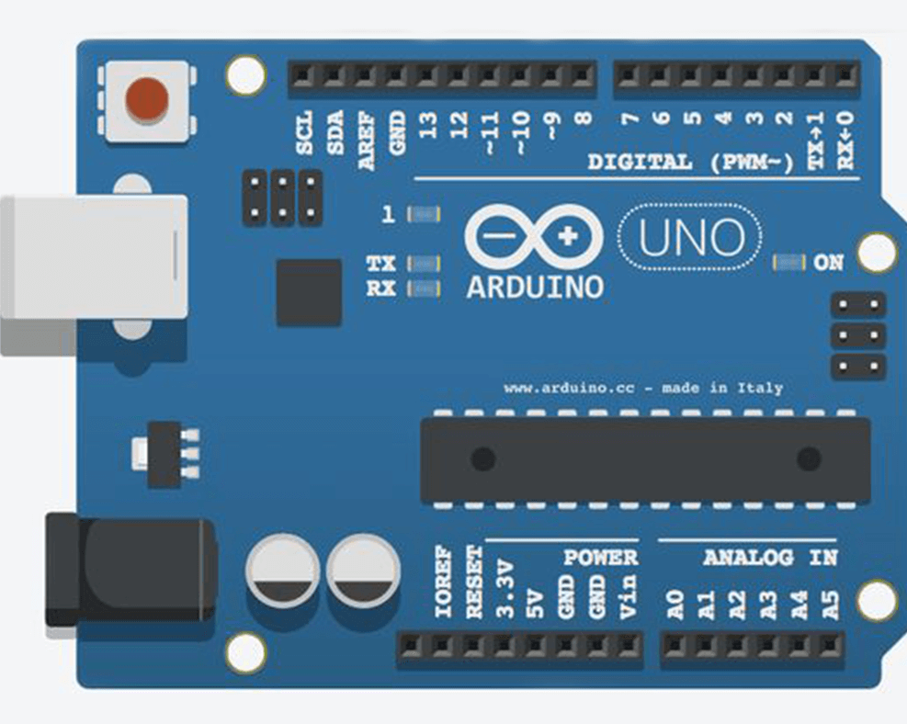
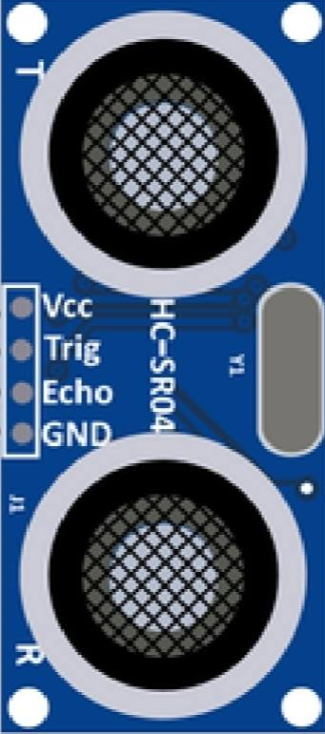
CIRCUIT DIAGRAM
MOTOR 1
MOTOR 2
BATTERY
12V

Slide 9
CONCLUSION
Our system will provide a better solution to clean the open area automatically and collect the waste which can be further transportable to dumping areas.

Slide 10
THANKYOU

